Slide 1
Section 2.5 Continuity

Slide 3
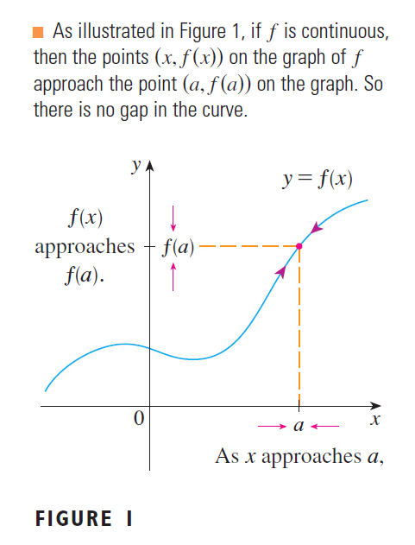

Slide 4
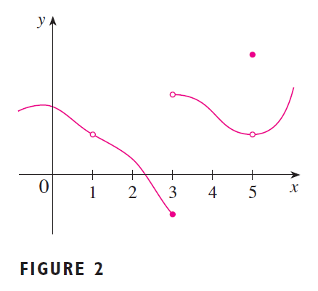

Slide 5
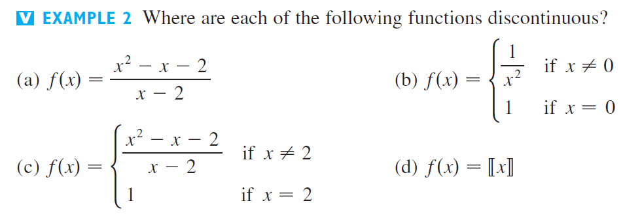
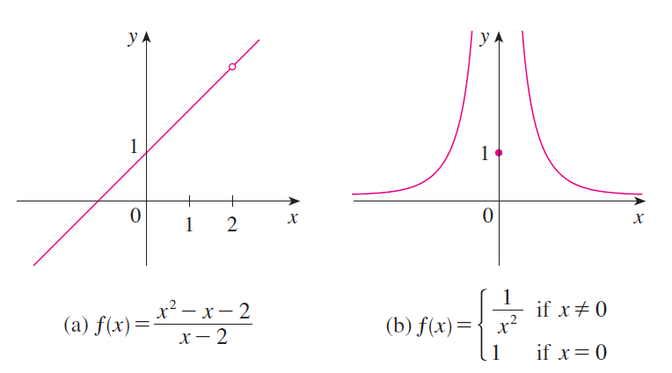
The discontinuity in part (a) is called a removable discontinuity because we can remove it by redefining the function f at just one single point.
The discontinuity in part (b) is called an infinite discontinuity.

Slide 6
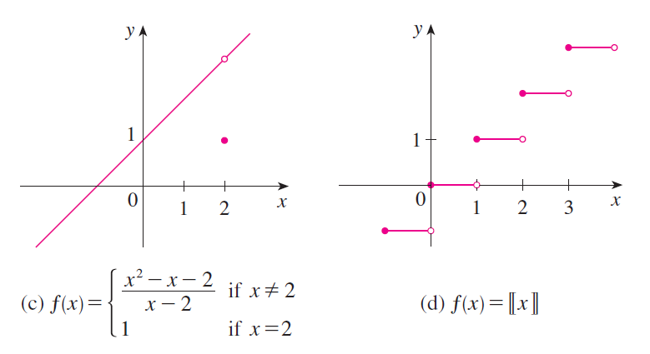
The discontinuity in part (c) is called a removable discontinuity because we can remove it by redefining the function f at just one single point.
The discontinuities in part (d) are called jump discontinuities.

Slide 8
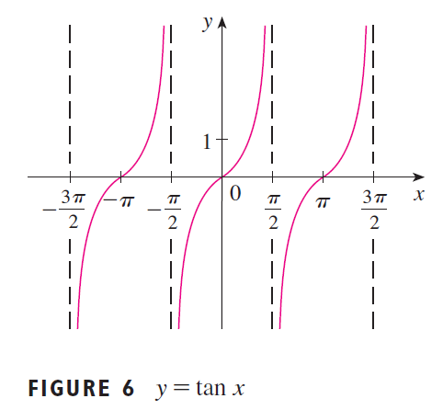

Slide 10
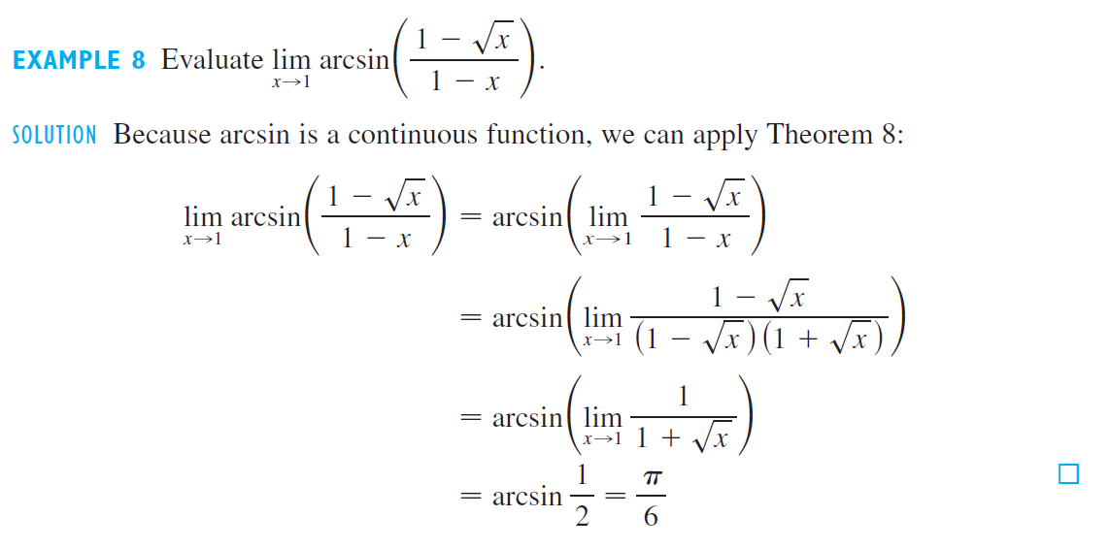

Slide 12
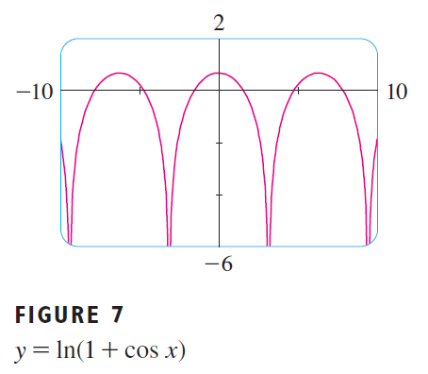

Slide 13
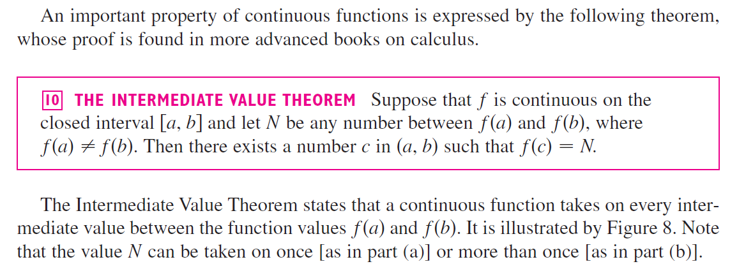
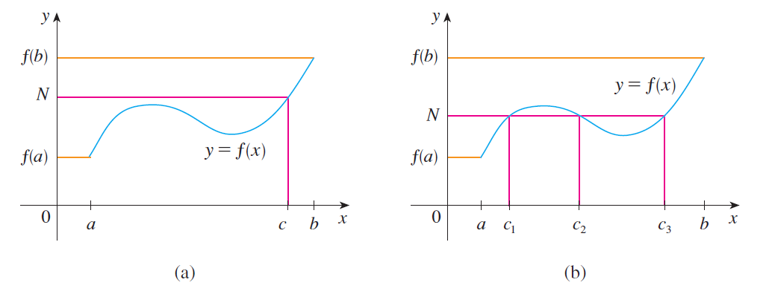

Slide 14
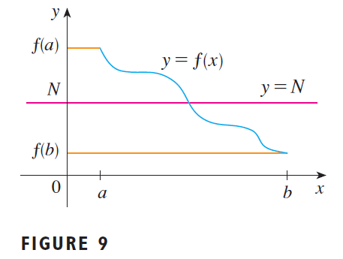

Slide 15
